Slide 1




IBM HR Data Analysis
By Omnia Mohamed

Slide 2


Agenda:
Who Are We?
Understanding the Data
Data Cleaning Process
Dashboards & Key Insights
Conclusion

Slide 3
Data Overview
The Story of Data Visualization
Main Business Question
Data Cleaning Process:
Transformed 35-column HR dataset by converting numeric encodings into meaningful categories (e.g., education levels, job satisfaction).
Created calculated columns using DAX, such as:
- Experience Category: Junior, Mid-Level, Veteran.
- Retrenchment Risk Flag: High Risk / Low Risk.
Result: Cleaned data enabled clearer analysis and better decision-making.
Key Insights & Dashboards:
Workforce Overview: Employee demographics, gender distribution, job satisfaction, and age distribution.
Organization Development: Retrenchment, promotions, Job Satisfaction, Overtime, and Employee Performance

Slide 4

The Story of Data Visualization
"Although most employees perform at a high level, there is a gap in promotions and retention that hinders growth. Additionally, geographic distance impacts employee satisfaction and productivity. Addressing these issues with targeted strategies will unlock the full potential of IBM’s workforce.“

Slide 5
Main Business Question
How can IBM better leverage its workforce potential by improving promotions, employee retention, and overcoming geographic distribution challenges?
Supporting Questions:
1. Why are only 4.9% of employees getting promoted, even though 84.6% have high performance ratings?
2. Why do 42% of employees leave the company after just 3 years?
3. How does the distance between employees and the office affect their productivity and satisfaction?
4. Are there employees who are ready to take on future leadership roles?

Slide 6

Data Cleaning Process:
Data Cleaning by excel
Data Transformation by Power BI DAX
Data Modeling by DAX

Slide 7
Challenges Faced
1. Data Issues:
- Missing values in "Training Hours" column, which led to exclusions from training analysis.
- Mixed date formats required standardization.
2. Visualization Issues:
- Distance from office: Initial pie chart ineffective. Resolved by using a heatmap.
- Years of Service: Similar column heights in charts. Resolved using a waterfall chart.
3. Storytelling Challenges:
- Difficulty explaining why 84.6% high performers had only 4.9% promotion readiness.
- Added dedicated slide: 'Potential Disconnect Between Performance and Promotion Criteria'.

Slide 8
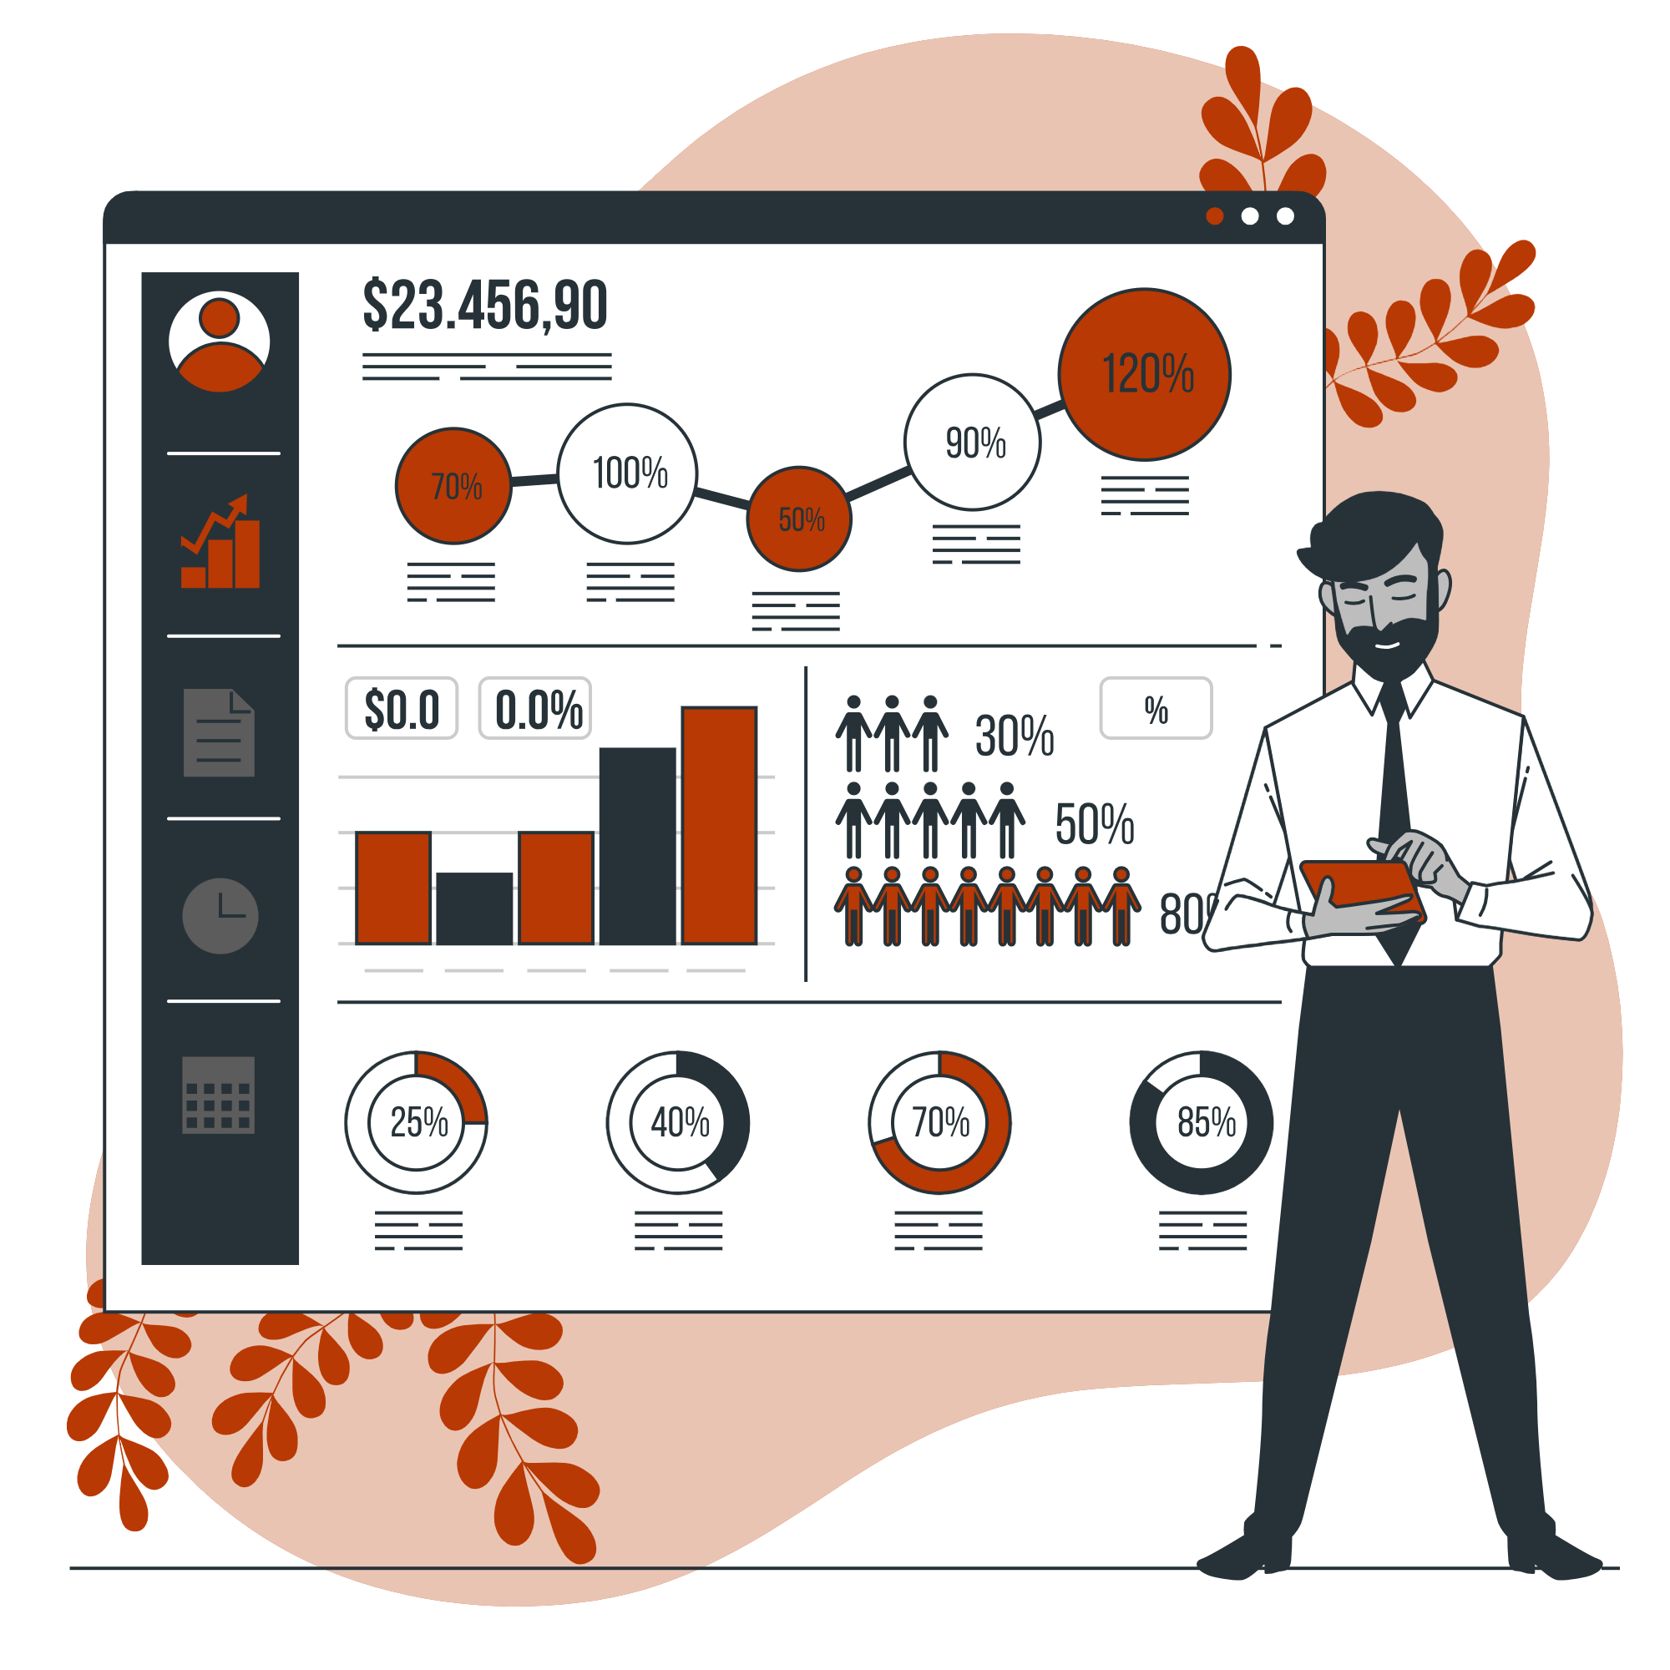
Dashboards & Insights

Slide 9
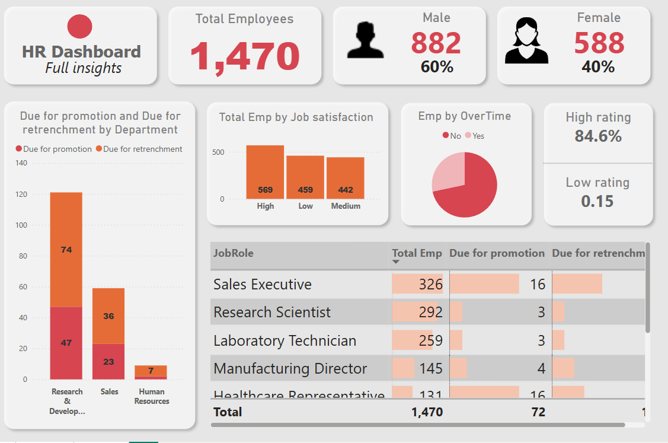
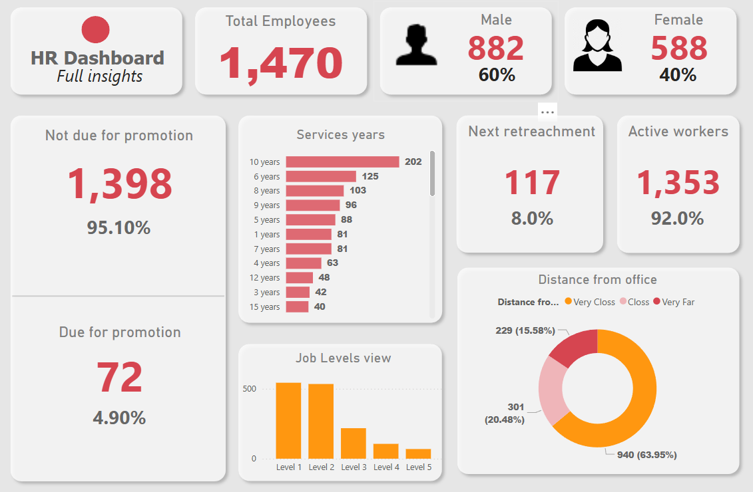
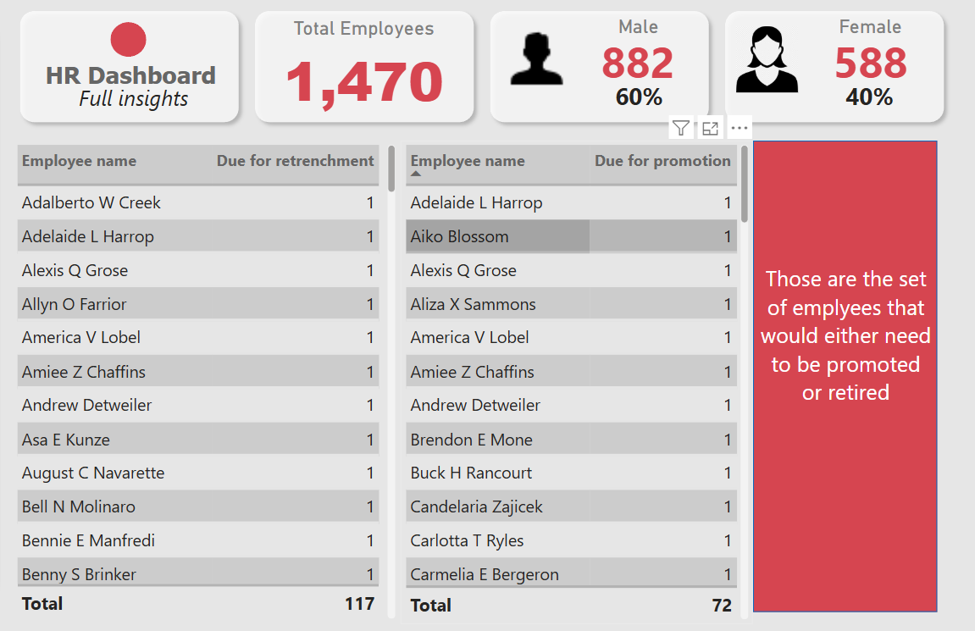
Employee Insights and Performance Blueprint
Summary:
This blueprint highlights key metrics such as employee headcount, salary, attrition, job satisfaction, and workforce demographics. It covers gender, age, education, overtime, tenure, and training hours, offering a concise view of employee performance for informed HR decisions.

Slide 11
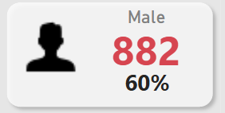
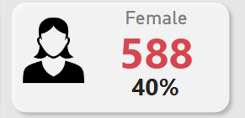
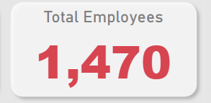
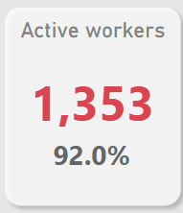
Workforce Overview
Content Overview:
Gender Distribution (Card): Shows a 60% male and 40% female distribution — indicates gender gap.
Total Employees (Card): Displays the total workforce number (1,470 employees).
Active Workers (Card): 92% of employees are active — reflects high engagement or availability.

Slide 12
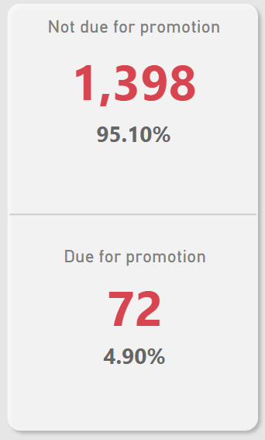
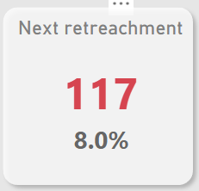
Promotion Management & Retention Watch
Content Overview:
Promotion Eligibility (Multiple Card): 95.1% not eligible, only 4.9% eligible — shows limited promotion movement.
Next Retrenchment (Card): 8% (117 employees) may soon be leaving or retiring — helps with workforce planning.

Slide 13
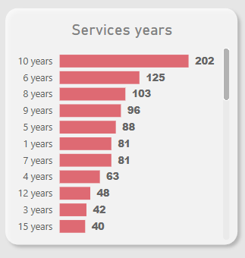
Employee Tenure: Years of Service
Chart Type : Bar Chart
Insight :
Strength: 202 employees with 10+ years tenure (institutional knowledge)
Risk: Only 42 employees at 3-year mark (potential retention cliff)
Pattern: "Mid-career hump" (peak at 10 years, then sharp drop)

Slide 14
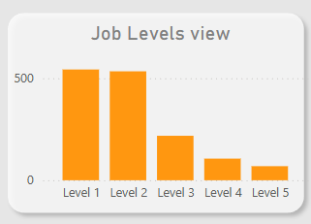
Talent Pipeline Analysis: Bridging the Leadership Gap
Chart Type : Clustered Bar Chart
Insight :
Structural Imbalance: Heavy concentration in junior levels (L1-L2)
Leadership pipeline risk (only 4% in L4-L5)
Potential skills gap in senior roles
Opportunity: Mid-level employees (L3) are prime candidates for promotion planning

Slide 15
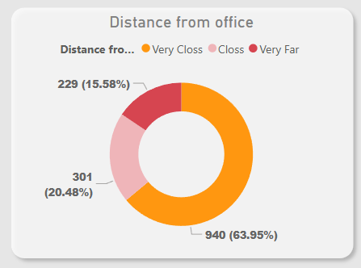
Workforce Geographic Distribution & Mobility Strategies
Chart Type : Donut Chart
Insight :
Critical Issue: 63.95% of employees live very far from the office, which may:
Increase tardiness/absenteeism (productivity risk)
Lower engagement (commuting fatigue)
Only 15.58% are very close (potential culture champions)

Slide 17
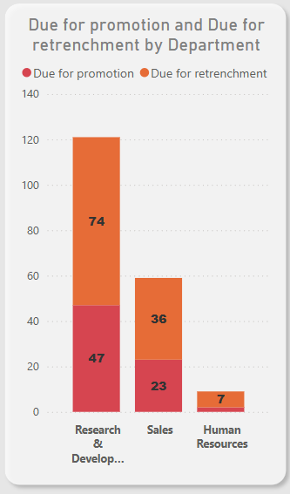
Due for Promotion and Retrenchment by Department
Chart Type : Stacked Column Chart
Insight :
The Research & Development department has the highest number of employees due for promotion (47) and retrenchment (74), indicating high turnover or upcoming changes in that area.

Slide 18
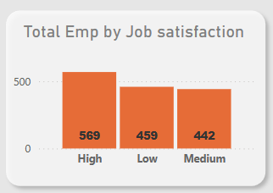
Total Employees by Job Satisfaction
Chart Type : Vertical Bar Chart
Insight :
Most employees report High satisfaction (569), but a significant number have Low (459) or Medium (442) satisfaction, signaling mixed engagement levels.

Slide 19
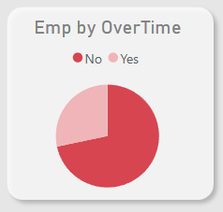
Employees by Overtime
Chart Type : Pie Chart
Insight :
The chart shows a visible number of employees working overtime, which may indicate workload issues or critical project periods.

Slide 20
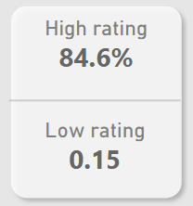
Employee Performance
Content Overview:
Total Employee (Card): 84.6% of employees have a high rating, while very few are rated low (0.15), suggesting strong overall performance.

Slide 21
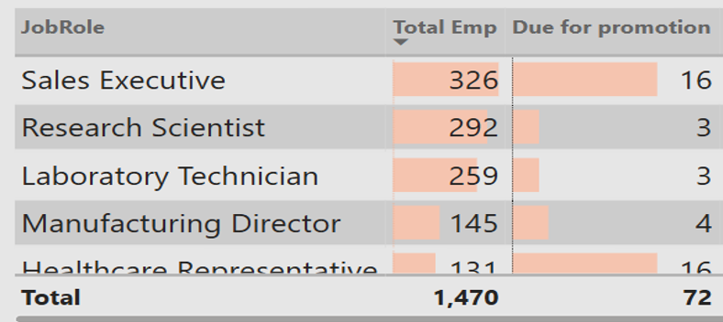
Job Role Overview (with promotion/retrenchment flags)
Chart Type : Table with Conditional Formatting Bars
Insight :
The largest employee groups are Sales Executives (326) and Research Scientists (292). Sales has the highest number due for promotion (16), while several roles show expected retrenchments — useful for workforce planning.

Slide 23
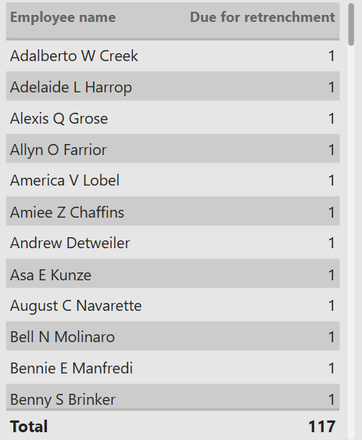
Employees Due for Retrenchment
Chart Type : Data Table
Insight :
Lists all 117 employees flagged for retrenchment — essential for HR exit planning or restructuring.

Slide 24
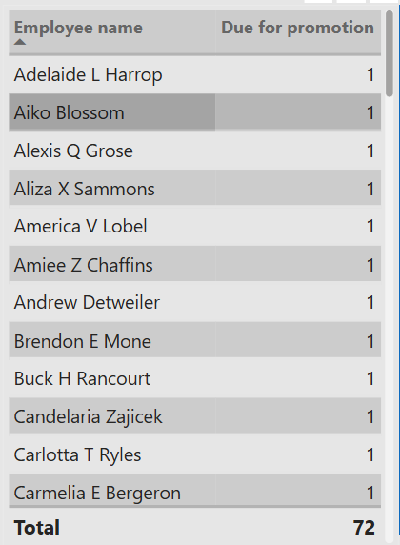
Employees Due for Promotion
Chart Type : Data Table
Insight :
Shows all 72 employees eligible for promotion — helps managers prioritize performance reviews and succession planning.

Slide 25
Recommendations & Action Points
1. Immediate Actions:
- Align performance ratings with promotion criteria.
- Launch mentorship programs for L3 employees.
- Pilot hybrid work policy for employees far from the office.
2. Long-Term Strategies:
- Build a leadership pipeline by upskilling L3 employees.
- Introduce 3-year retention bonuses to reduce attrition.
3. KPIs to Track:
- Promotion Rate: Increase from 4.9% to 10%.
- 3-Year Retention Rate: Improve from 58% to 75%.
- Promotion Speed: Reduce from 4.2 years to 2.8 years.

Slide 26
Thank you!
We appreciate your time and attention. Feel free to contact any of us for further discussions:
Gmail: omnia.youssef26@gmail.com
LinkedIn: https://www.linkedin.com/in/omnia26/

